Slide 1
POC 2020

Slide 2
Hello!
I am Abhishek Shukla
I am here because I done Two POC’s in POC 2020 for serverless

Slide 3
How serverless is different
Serverless Functions have three important properties, each of them having a significant impact on the way we deal with the cost of an application:
Low management overhead The cloud provider manages the service. The total cost of ownership is minimal: developers create code to solve business problems—the rest is taken care of.
Pay-per-use Functions are charged per actual executions. Nothing is reserved in advance, so the cost of running a Function App grows linearly with the application demand.
Elastically scalable When a Function is idle, Azure scales the infrastructure down to zero with no associated cost. Whenever the workload grows, Azure brings enough capacity to serve all the demand.

Slide 4
Billing model of consumption plan
The structure of the Consumption plan. There are two core components of the cost of serverless Functions in Azure: Execution Count and Execution Time.
Execution Count is straightforward. Each Function defines a trigger—an event which causes the code to execute. It can be an incoming HTTP request or a message in a given queue. Every call counts: you get charged $0.20 per million executions. This component of the cost can be substantially reduced if you batch events: process several events in a single execution.
Execution Time on the pricing page, which isn't exactly correct: it depends on both completion time and memory consumption and is metered in GB-seconds. You pay $16 per million GB-seconds. That is, if a Function runs 1 million times, it always consumes 1 GB of memory and completes in 1 second, you pay $16.
The memory consumption is always rounded up to the next 128 MB, and the minimum time charge is 100 milliseconds. Therefore, the minimal time charge is again $0.20 per million executions.

Slide 5
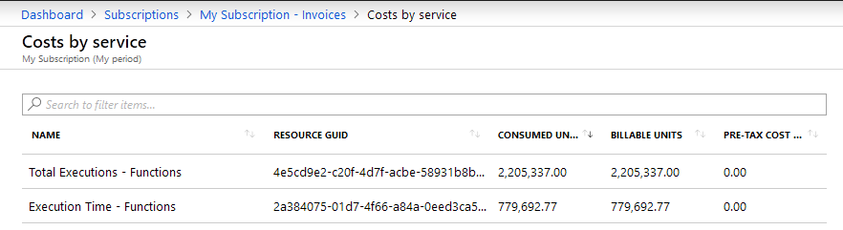
Billing and cost analysis
Open the Azure portal and navigate to your subscription's page, choose Invoices and then a period to look at. Here's a sample report from a subscription :
Execution Count is straightforward. Each Function defines a trigger—an event which causes the code to execute. It can be an incoming HTTP request or a message in a given queue. Every call counts: you get charged $0.20 per million executions. This component of the cost can be substantially reduced if you batch events: process several events in a single execution.
Execution Time on the pricing page, which isn't exactly correct: it depends on both completion time and memory consumption and is metered in GB-seconds. You pay $16 per million GB-seconds. That is, if a Function runs 1 million times, it always consumes 1 GB of memory and completes in 1 second, you pay $16.

Slide 6
Cost Beyond functions
There are several other potential costs associated with running an Azure Function App:
Application Insights Depending on the event volume and sampling settings, the cost of this monitoring service can become quite substantial and exceed the cost of Azure Functions themselves. Be careful and test your configuration before and soon after going to production.
Network traffic If your Functions serve the traffic to the outside world, the networking fees apply. They are usually relatively low, but the cost may build up for high-volume Functions serving bulk data.
Storage Azure Functions use a Storage Account for internal state and coordination. In my experience, these costs are negligible.

Slide 7
Other hosting plan for Azure functions
Azure Functions can be hosted in other ways:
App Service plan with a fixed cost per hour,
Premium plan with both fixed and variable price components,

Slide 8
1.
Serverless : Contact us Form
Let’s start with the architecture first

Slide 9
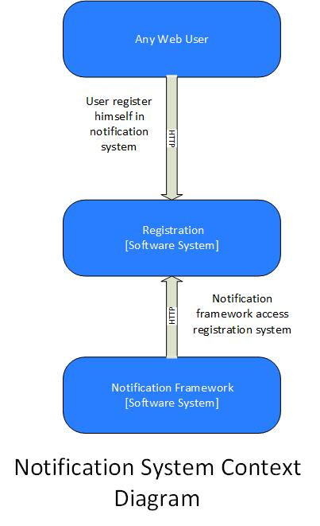
Level 1: System Context diagram
A big picture of the system landscape. The focus should be on people (actors, roles, personas, etc) and software systems rather than technologies, protocols and other low-level details. It's the sort of diagram that you could show to non-technical people.

Slide 10
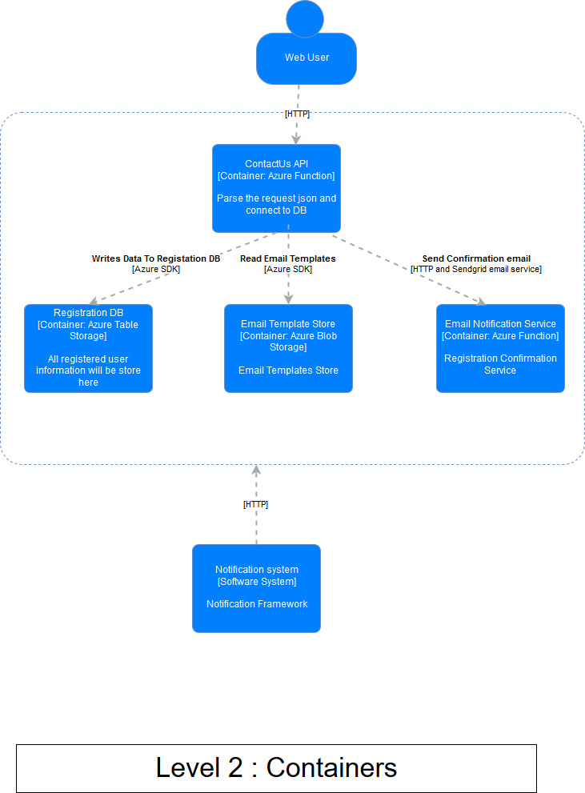
Level 2: Container diagram
Container diagram shows the high-level shape of the software architecture and how responsibilities are distributed across it. It also shows the major technology choices and how the containers communicate with one another. It's a simple, high-level technology focused diagram that is useful for software developers and support/operations

Slide 11
Level 3: Component diagram
The Component diagram shows how a container is made up of a number of "components", what each of those components are, their responsibilities and the technology/implementation details.

Slide 12
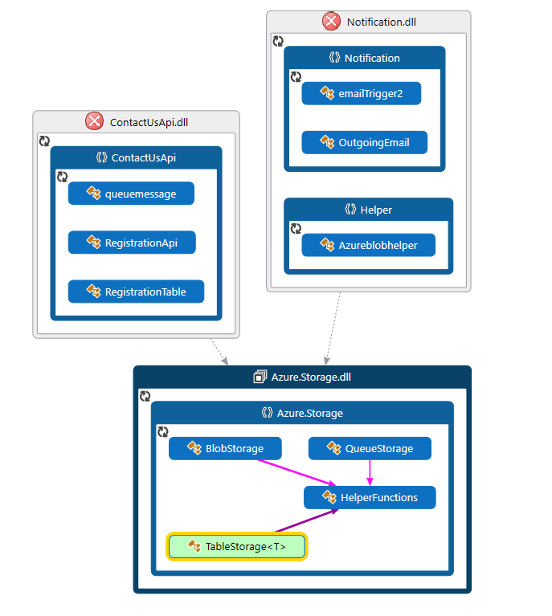
Level 4: Code
This is an optional level of detail and is often available on-demand from tooling such as IDEs. Ideally this diagram

Slide 13
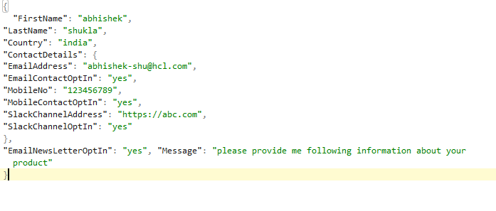
Code Walkthrough and Demo
Input Json

Slide 14





Registration Db
Email Templates
Message Queue
User
Sendgrid Email
Registration Service
Notification System
Registration and Notification

Slide 15
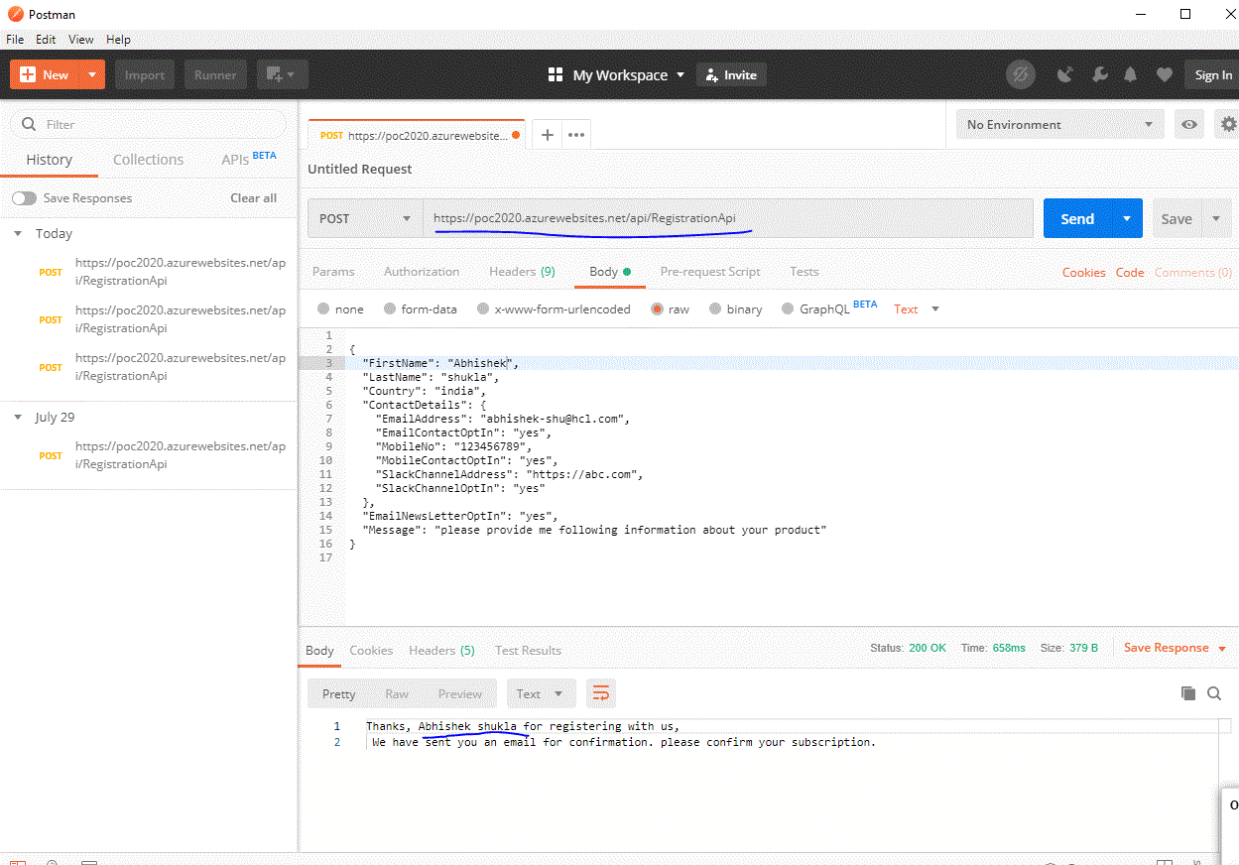
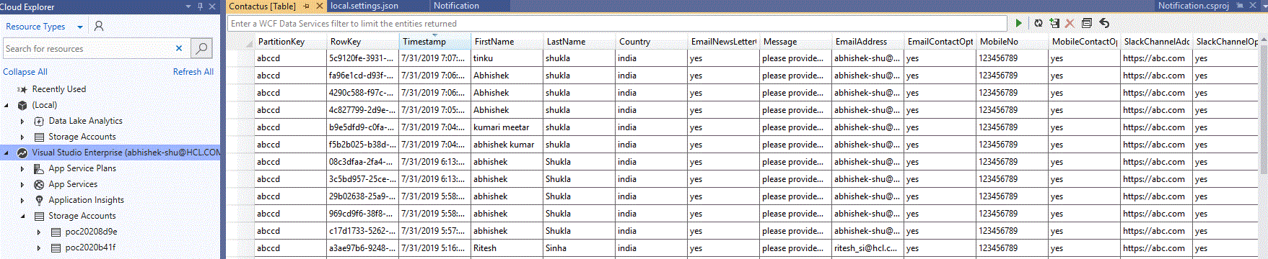
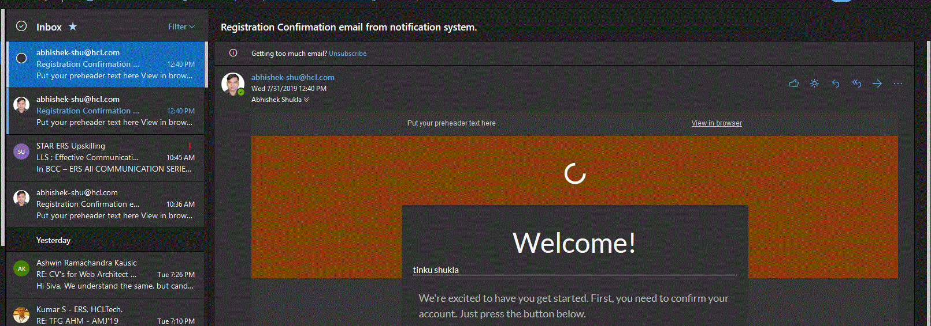
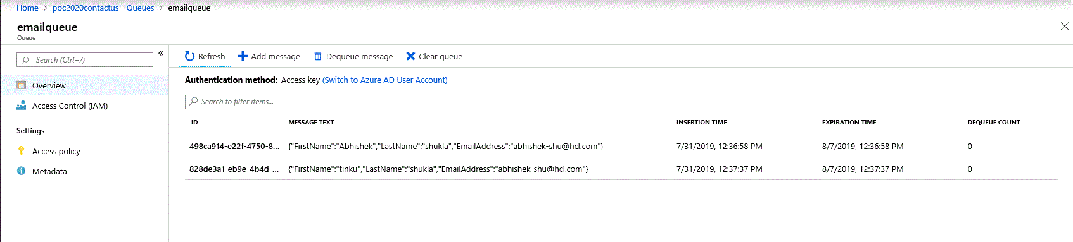

Slide 16
2.
Serverless : Url Shortner
.

Slide 17
URL shortening is a technique on the World Wide Web in which a Uniform Resource Locator (URL) may be made substantially shorter and still direct to the required page. This is achieved by using a redirect which links to the web page that has a long URL.

Slide 18
Requirements and Goals of the System
URL shortening system should meet the following requirements: Functional Requirements:
Given a URL, our service should generate a shorter and unique alias of it. This is called a short link. This link should be short enough to be easily copied and pasted into applications.
When users access a short link, our service should redirect them to the original link.
Users should optionally be able to pick a custom short link for their URL.
Links will expire after a standard default timespan. Users should be able to specify the expiration time.

Slide 19
Other Requirements
Non Functionals
The system should be highly available. This is required because, if our service is down, all the URL redirection will start failing.
URL redirection should happen in real-time with minimal latency.
Shortened links should not be guessable (not predictable).
Extended
Analytics; e.g., how many times a redirection happened?
Our service should also be accessible through REST APIs by other services.

Slide 20
Use Cases
# Case | # Input Json | # Response
Url without any user assigned shortcode | { "Url": "http://maniappan.blogspot.com", "RequestedShortCode": "", "Country": "india", "IpAddress": "yes", "UserName": "Abhishek Shukla"} | {"Url":"http://maniappan.blogspot.com","ShortCode":"cf57f","OperationStatus":"UrlShortned","Message":"Short
Already registerd | { "Url": "http://maniappan.blogspot.com", "RequestedShortCode": "", "Country": "india", "IpAddress": "yes", "UserName": "Abhishek Shukla"} | {"Url":"http://maniappan.blogspot.com","ShortCode":"cf57f","OperationStatus":"UrlExistsWithOtherShortCode","Message":"Url

Slide 21
Code Walk Through
https://github.com/ERS-HCL/Serverless-UrlShortner

Slide 22
Azure Vs AWS
 | Azure | AWS
No SQL Storage | Table Storage | Simple Db
Compute | Azure Function | AWS Lambda
Storage | Blob Storage | S3 Bucket

Slide 23
Thanks!
Any questions?
You can find me at:
Abhishek-shu@hcl.com

